Slide 1
iChange Climate Change and Me

Slide 2
Aims and objectives
To understand the notion of sustainability and explore what this means.
By the end of the session to have:
Investigated the meaning of sustainability, climate change and the greenhouse effect.
Shared their own feelings about climate change.
Recorded key questions for further investigations.

Slide 3
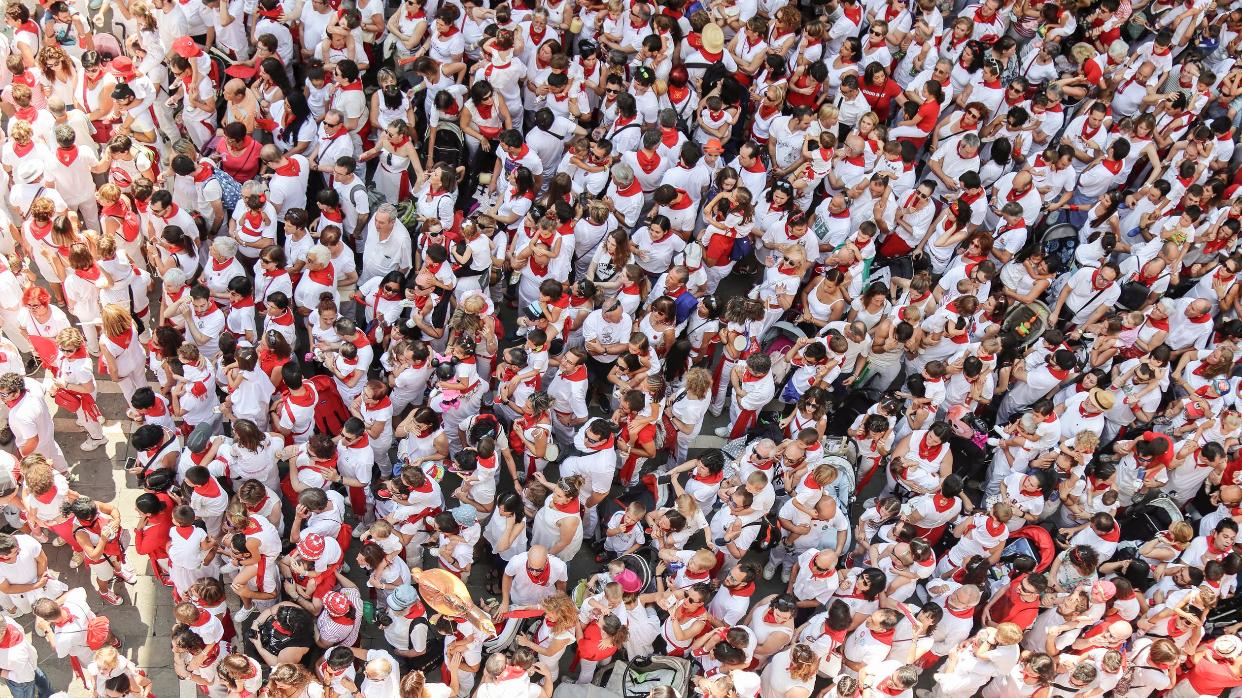
What Is Sustainability?
The number of people living on earth has doubled over the last century

Slide 4
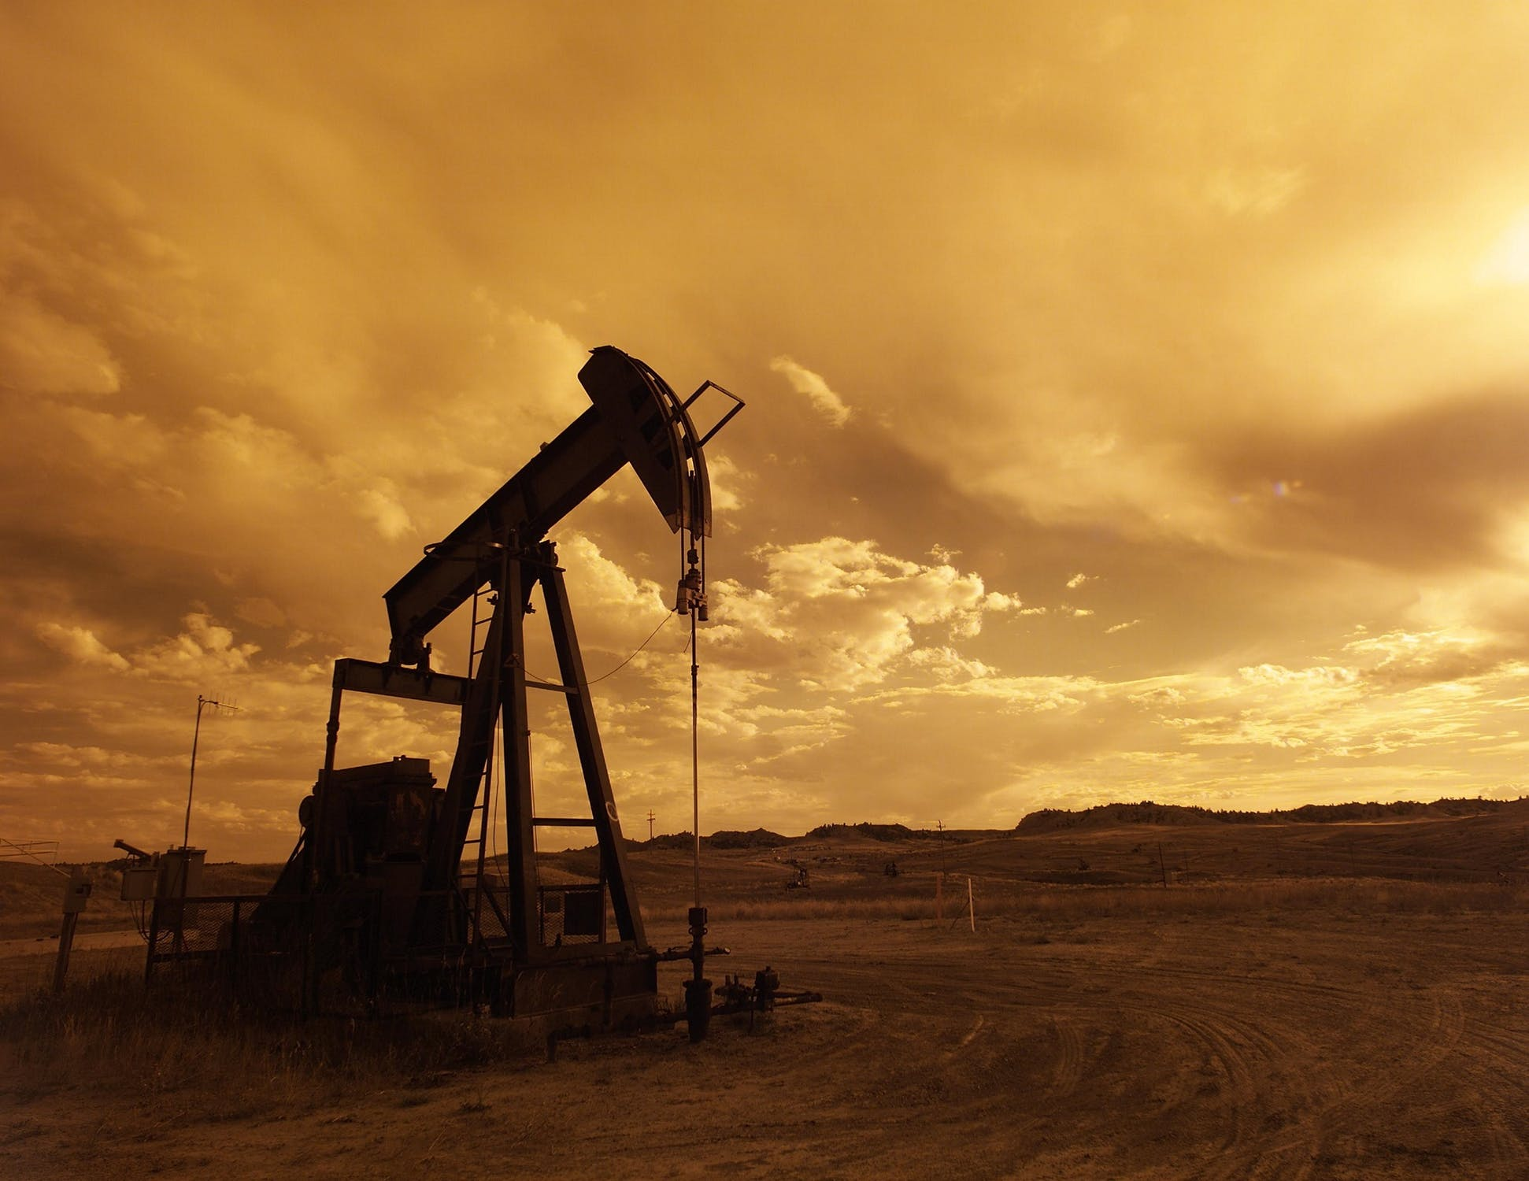
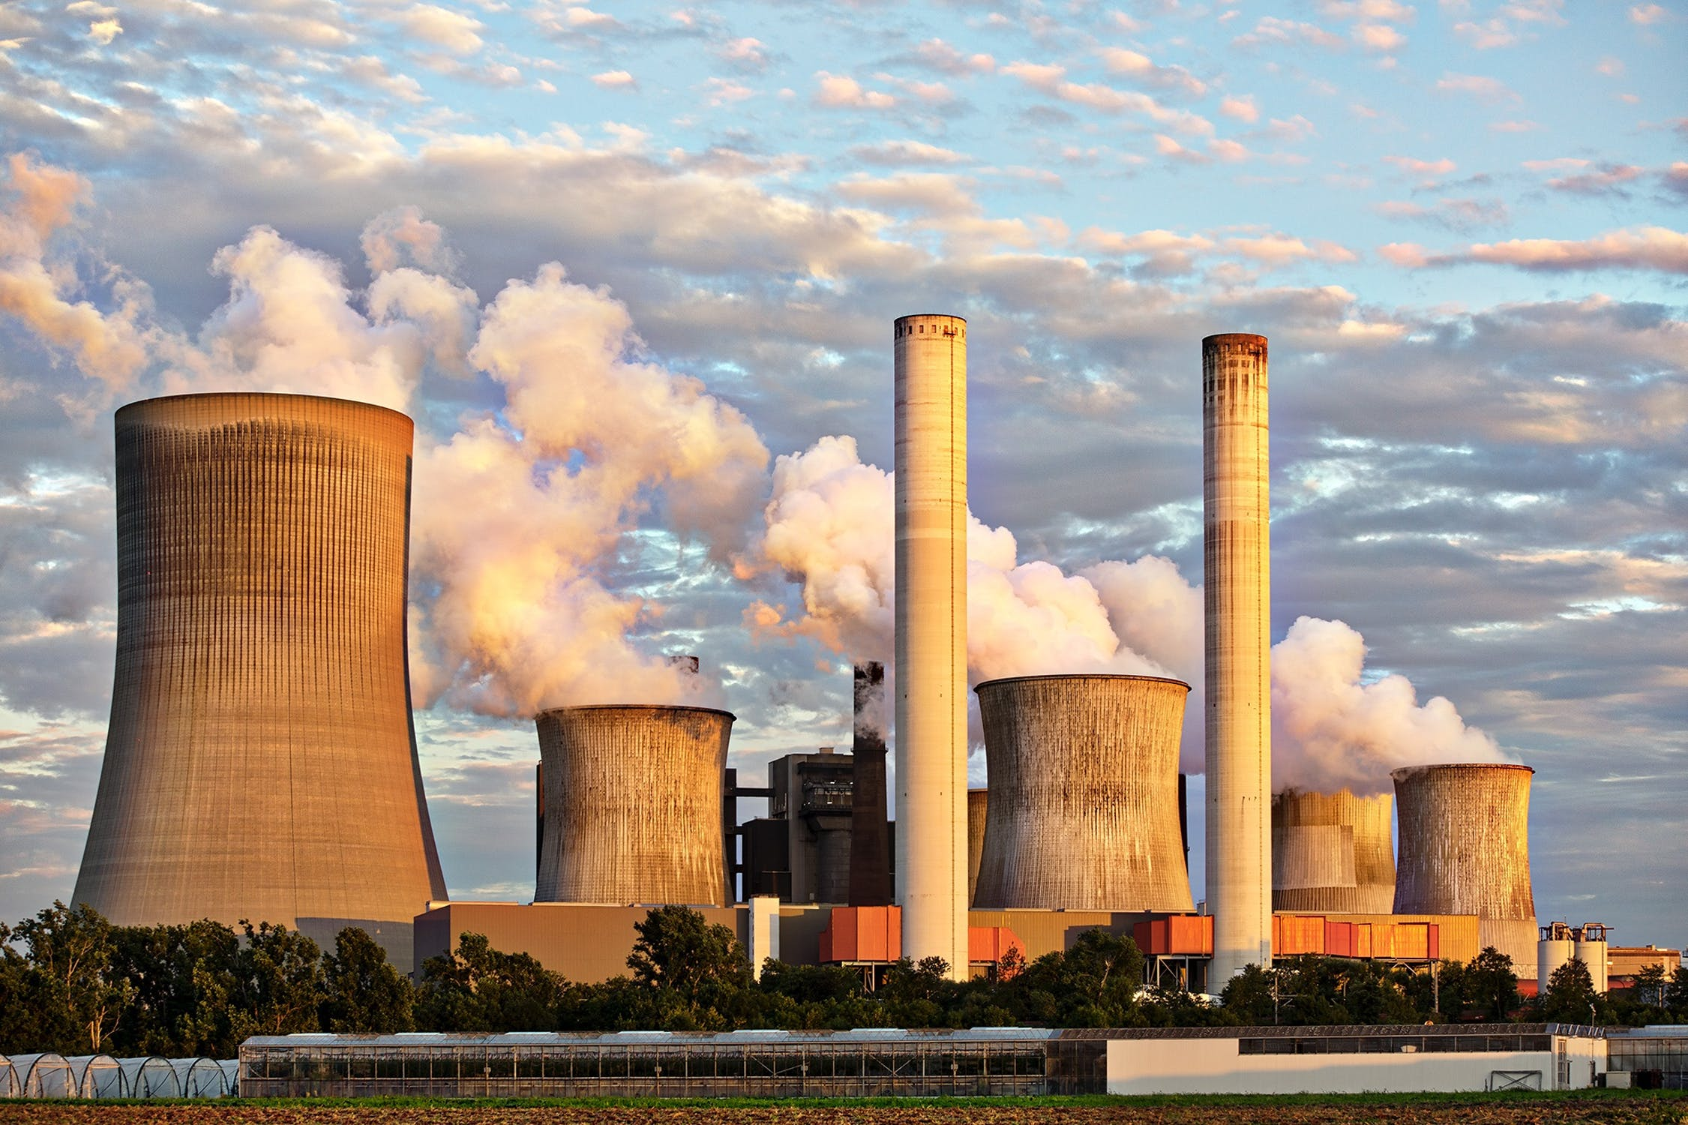
What Is Sustainability?
A small number of these people use huge amounts of the earth's resources like land, energy and water.

Slide 5
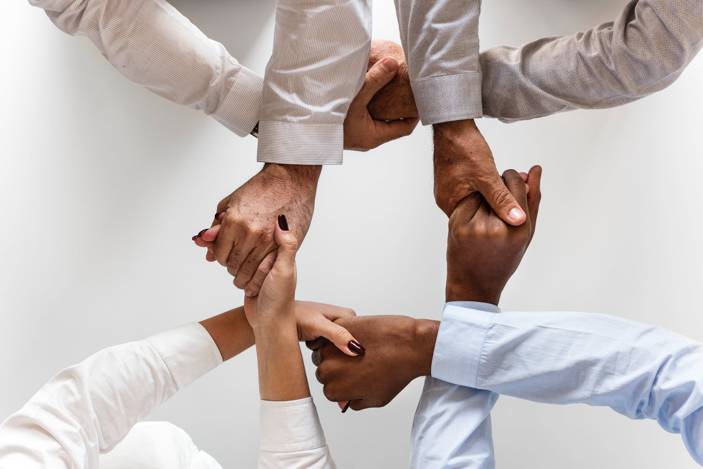
What Is Sustainability?
We need to share the Earth’s resources equitably and reduce our demand for them so that everyone, now and in the future, can benefit.

Slide 6
What Is Sustainability?
‘To behave in a way that not only makes our lives better today, but also means that people in the future will be able to live well’.

Slide 7
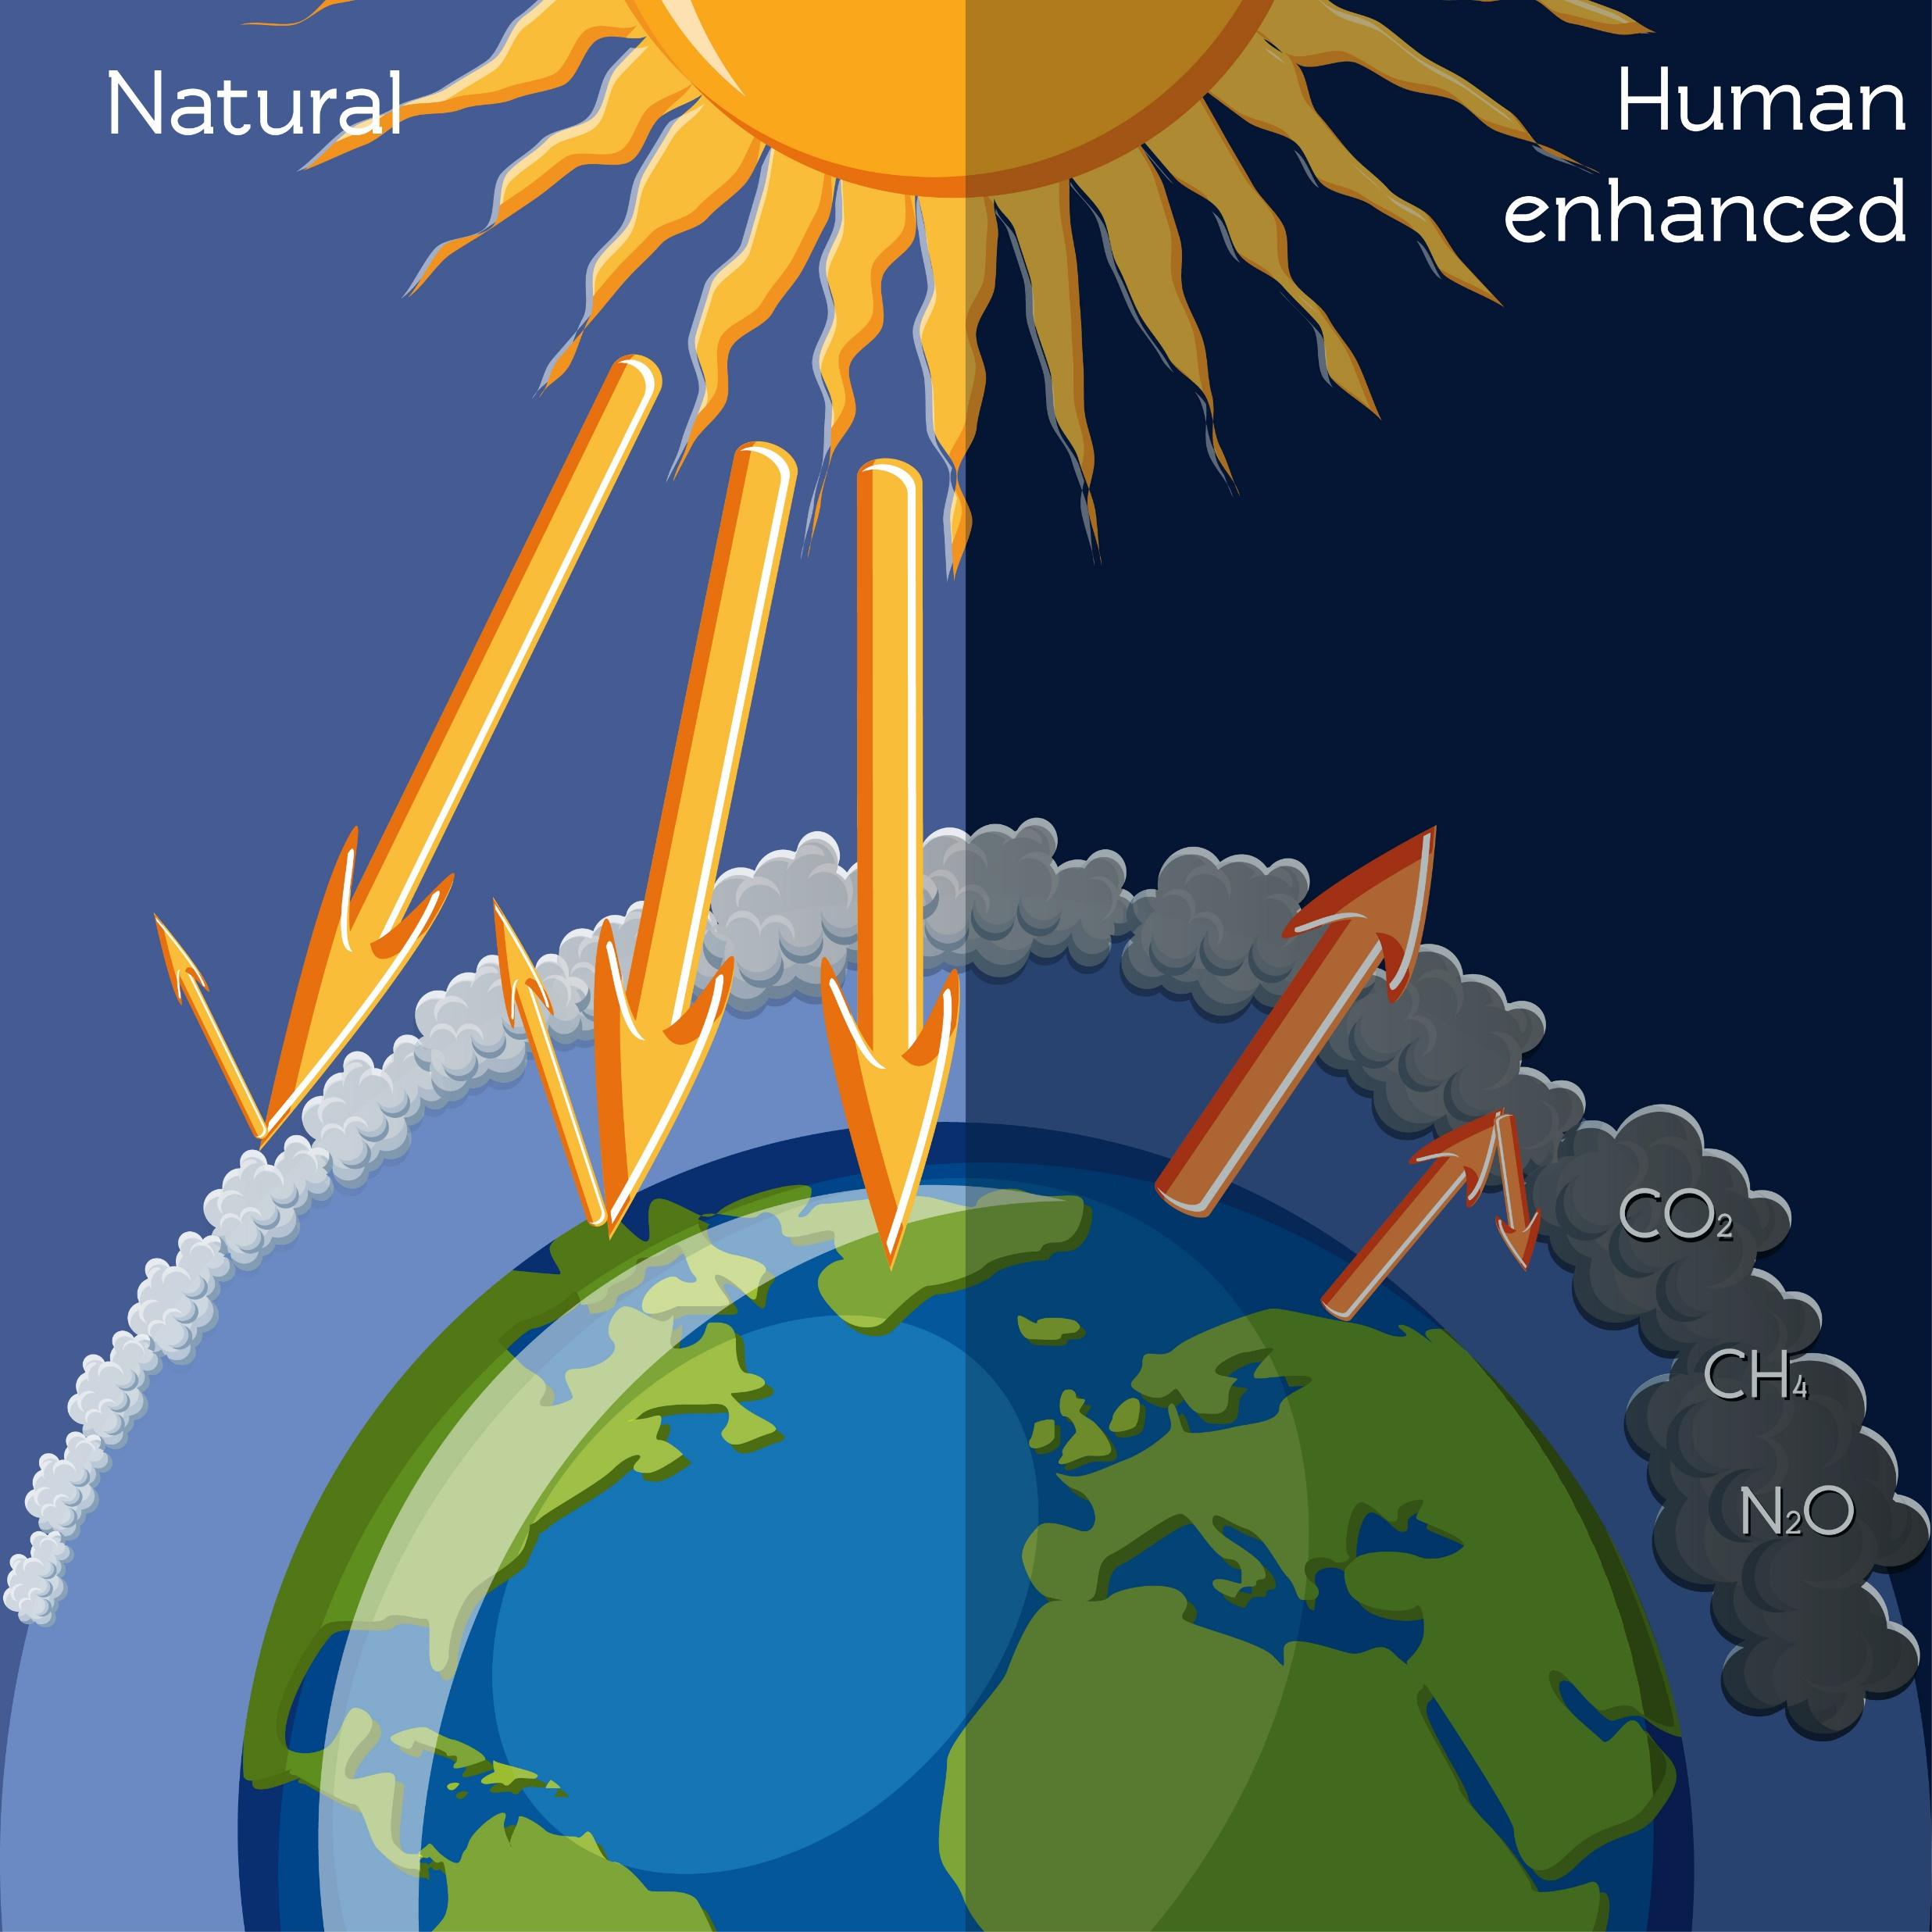
The Greenhouse Effect
This occurs when heat from the sun is trapped in the atmosphere by gases.
The main one is carbon dioxide.

Slide 8
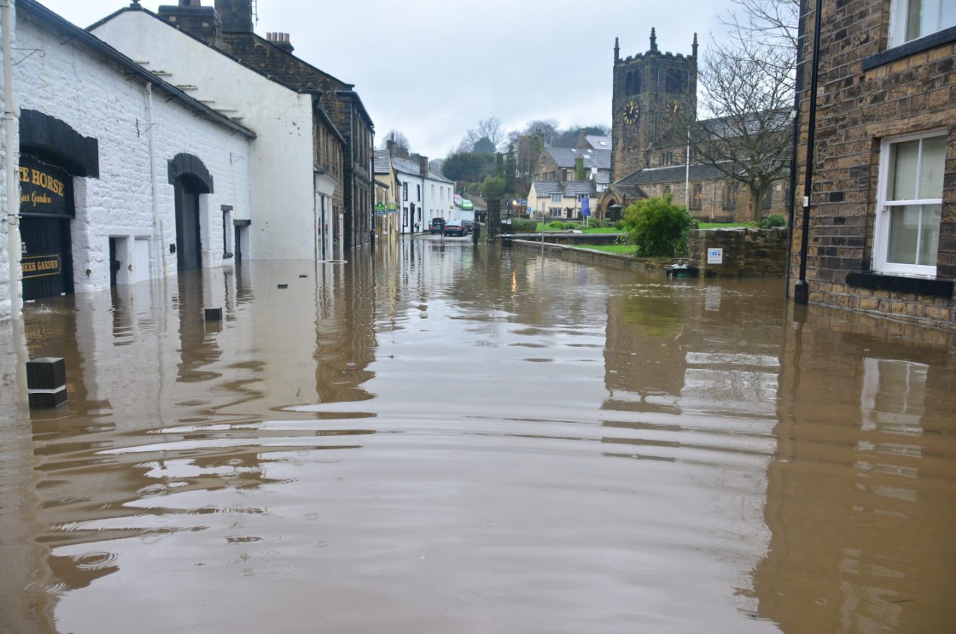
The Greenhouse Effect
Photo by Chris Gallagher on Unsplash
Carbon dioxide is produced when we burn ‘fossil fuels’ to obtain energy.
Scientists have demonstrated that the greenhouse effect is causing ‘climate change’.
These scientists evidence that climate change causes extreme weather conditions.

Slide 9
Data Race
At the word ‘Go’, one person from each group takes a card from the desk, takes the first question only and takes it back to the group.
You can get your information from:
PEEP https://www.peep.ac.uk/content/1833.0.html
NASA https://climate.nasa.gov/causes/
Your group / helper knowledge
Write down the answer on a separate piece of paper.
A second person takes this to the front.
The answer is checked. If it is accurate and complete, the second question is collected.
... and so on.
If any answer is inaccurate or incomplete, the ‘runner’ will be sent back to the group to try again.
The first group to complete all the answers ‘wins’.

